Slide 1
DESIGN YOUR CODE…AND WRITE LESS OF IT!
FAIR² training program
R. Thomas and M. Dyer
RSE team

Slide 2


Who are we?
Romain Thomas
romain.thomas@sheffield.ac.uk
Head of RSE
Martin Dyer
martin.dyer@sheffield.ac.uk
Research Software Engineer

Slide 3
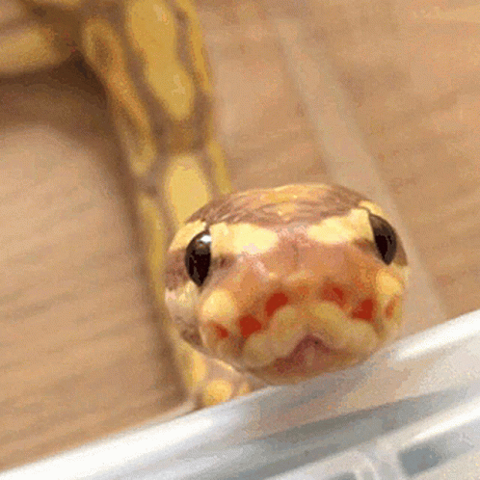

Before we start:
For this course we will be using Python. You should have:
- Python 3.9+
- Pylint 3.0.3+
–No need for extra packages–

Slide 4
What are we going to talk about?
FAIR principles: reminders [Today]
Why should you care? [Today]
Learn about readability, reusability and maintainability
Code Structure [Today]
Learn to gather functionalities in function/classes and organise your code
The Zen of Python [Today]
Learn to write code correctly with the proper syntax
Principles of Code Design [Tomorrow]
Learn how to recognise problems in a code and how to tackle them
Stop touching your code!!!!!! [Tomorrow]
Learn how to stop touching your code when you run it with different input!

Slide 5

How are we going to talk about?
Code is read more often than it is written.
Guido Van Rossum, Creator of Python
The goal of this lecture is to make you think about code.
We will read code together
We will write code together

Slide 6
Reminder: What is a research software?
“Research Software includes source code files, algorithms, scripts, computational workflows and executables that were created during the research process or for a research purpose.”
Barker et al. Scientific Data 9:622 (2022) “Introducing the FAIR Principles for research software”

Slide 7
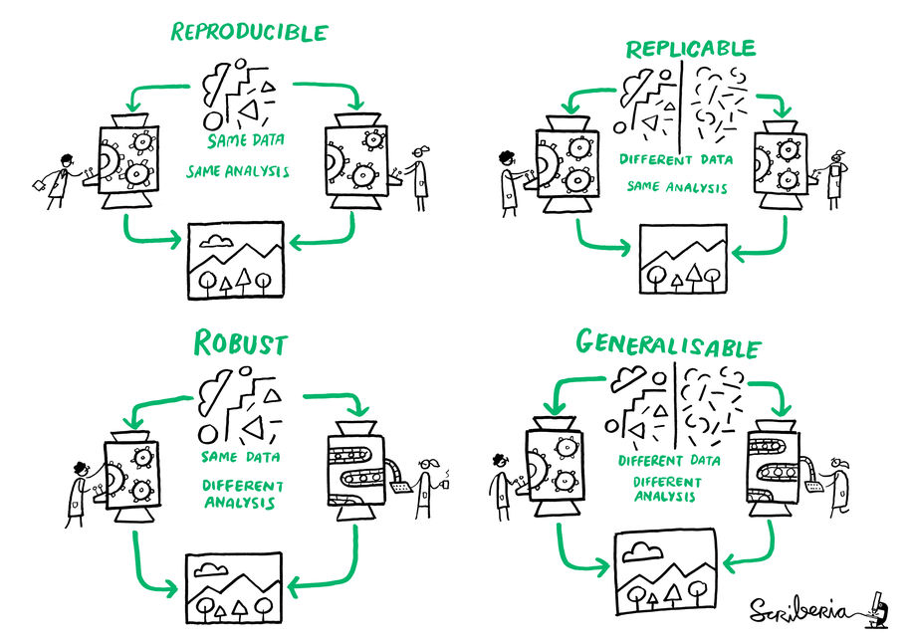
Reminders: The FAIR principles
Software is an essential part of research
Sharing this important aspect of the research process with others is vital for reproducible and open research
Image by Scriberia for The Turing Way community, used under a CC-BY license https://zenodo.org/record/3332808

Slide 8
Reminders: The FAIR principles
Findable Software, and its associated metadata, is easy for both humans and machines to find
Accessible Software, and its metadata, is retrievable via standardised protocols
Barker et al. Scientific Data 9:622 (2022) “Introducing the FAIR Principles for research software” DOI: 10.1038/s41597-022-01710-x
Notes:
FINDABLE: Research software should have a globally unique and persistent identifier (e.g., DOI or a persistent URL) so that it can be easily found and cited. Sufficient metadata should be provided to help users discover the software. This includes descriptions of the software's function, version information, authorship, and where to access it. The software and its metadata should be indexed in searchable repositories so it can be discovered via common search engines and research infrastructure platforms (e.g., Zenodo, GitHub, or institutional repositories).
ACCESSIBLE: The software should be easily retrievable using the unique identifier. Typically, this involves storing the software in a trusted repository that ensures long-term access. Clear information about the conditions under which the software can be accessed should be available, including open access options, if applicable. This ensures users understand whether they can freely use or adapt the software.

Slide 9
Reminders: The FAIR principles
Interoperable Software interoperates with other software by exchanging data and/or metadata, and/or through interaction via application programming interfaces (APIs), described through standards
→ Writing code in a modular way and using standard coding practices allows other people and other system to us it
Reusable Software is both usable (can be executed) and reusable (can be understood, modified, built upon, or incorporated into other software)
→ Use of docstrings, comments, and documentation makes it easier for others (AND YOU!) to understand, use and modify the code.
Barker et al. Scientific Data 9:622 (2022) “Introducing the FAIR Principles for research software” DOI: 10.1038/s41597-022-01710-x
Notes:
INTEROPERABLE: The software should use standardized data formats and interfaces where possible, allowing it to work with other software, tools, or systems. Clear documentation should be provided so users know how to integrate the software with other tools or systems. Where possible, the software should implement and support established protocols, formats, and APIs that are widely adopted in the research community.
REUSABLE: The software should be well-documented, including clear instructions on how to install, run, and modify it. The metadata should describe how and where the software can be reused, including dependencies, versioning, and requirements. An appropriate open or permissive license should be provided to ensure that others can legally reuse, modify, and redistribute the software. Adhering to coding standards, including the use of tests and continuous integration (CI), enhances the reliability and reusability of the software.

Slide 10
Reminders: The FAIR principles at UoS
‘‘We aspire to open research culture that values a diverse range of contributions and adheres to the FAIR principles to enable the results of our research to be of maximum benefit to society (findable, accessible, interoperable and reusable), whilst also respecting circumstances that limit data sharing (for example, due to issues of privacy, non-consent, contractual agreements, legislation or practicality).’’
University of Sheffield, Statement on Open Research
https://www.sheffield.ac.uk/openresearch/university-statement-open-research

Slide 11
Reminders: The FAIR principles
“Open source software ideally should start working toward satisfying the FAIR4RS Principles when it is initially being developed”
Barker et al. Scientific Data 9:622 (2022) “Introducing the FAIR Principles for research software” DOI: 10.1038/s41597-022-01710-x

Slide 12

Why should you care?
Knowledge is humankind’s most precious treasure. Everything that we accomplished has been done due to the capacity to create a transmisible heritage, which spare each new generation the task of starting from scratch. -B. Sirbey
Reproducibility and Reliability: In order for research results to be reliable and trusted, they have to be shared.
→ Sharing clean, well-structured, easy to read and use code will increase the reliability of your research

Slide 13
Why should you care?
Efficiency and maintainability: A research project (and code) can span several years and involve multiple contributors. You should not have to take three days each time you try to understand the piece of code from a colleague (or yours)
→ Clean, well structured, easy to read and use code reduces times and effort to understand, troubleshoot, implement new features or adapt it.
Collaboration and community contribution:
→ Clean, well structured, easy to read and use code is welcoming and will attract people!
→ More collaboration, more robust, more ideas, more research…

Slide 14
Why should you care?
Your research might rely heavily on your code.
Writing clean and well structured code
Increase the quality of your research, your reputation and your impact on your research domain

Slide 15
Some definitions: Readability
Key aspects: Descriptive namings, consistent formatting, comments, code structure
Benefits:
-Maintainability: Easier to understand and modify, reduce risk of errors
-Collaboration: Enhance teamwork and make it easy for others to contribute
-Efficiency: Saves a lot of time
-Quality: Reduces risk of errors
Readability in software refers to how easily a human reader can understand the purpose, control flow, and operation of the code.

Slide 16
Some definitions: Reusability
Key aspects: Modularity, abstraction, generic function, parametrization, no hardcoded values
Benefits:
-Time saving: Saves dev time, no need to rewrite from scratch
-Consistency: Reusing same code across different projects ensures consistency in functionality and behavior
-Maintainability: Reusable components can be maintained and updated independently
Reusability in software refers to the ability to use existing software components across multiple projects without significant modifications. Design to be generic and flexible.

Slide 17
Some definitions: Maintainability
Key aspects: Modularity, readability, testability, reusability
Benefits:
-Lower maintenance: Easier to refactor and improve over time
-Flexibility: Easier to integrate new features and make updates.
-Productivity: Can be easily understood, spend more time working on new features
Maintainability in software refers to the ease with which a software can be modified to correct faults, improve performance and adapt to change

Slide 18

We are going to watch two pieces of code. For each of them you will have have to tell me if the code is Readable, maintainable, and reusable
5 minutes / code

Slide 19
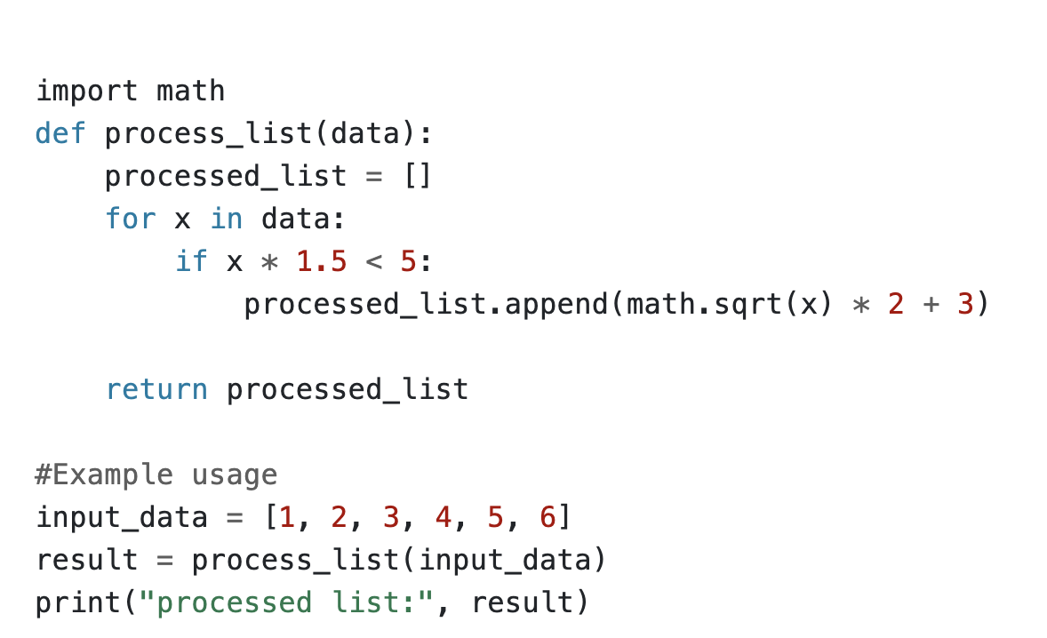
Code Quiz #1

Slide 20
Code Quiz #1
- Reusable: The function can be used with any list of integers to filter and transform the data.
- Partially readable: Uses a simple structure that is easy to follow. But it is impossible to understand its purpose. There are no comments explaining what the function is doing or why it’s doing it.

Slide 21
Code Quiz #1
What are these numbers?
What if x < -1?
Why?
Not maintainable!!!

Slide 22
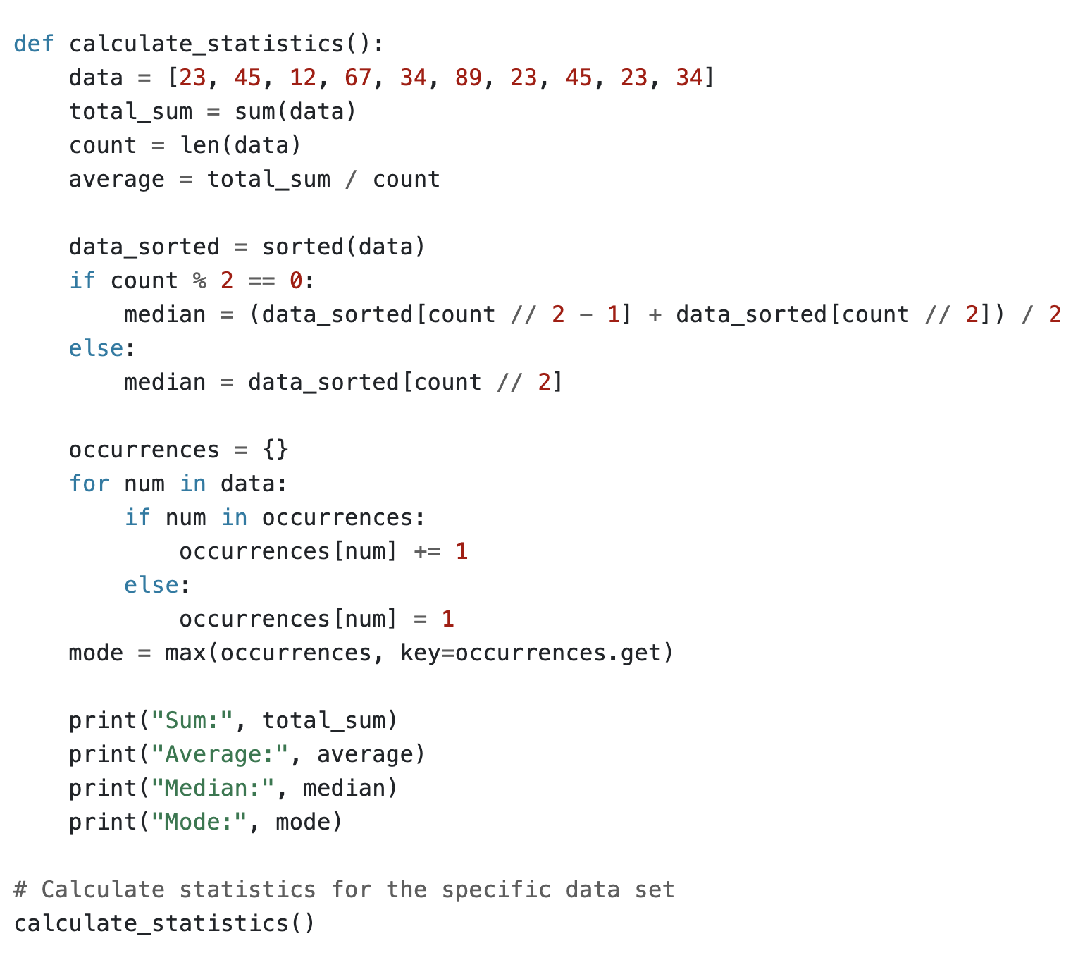
Code Quiz #2

Slide 23
Code Quiz #2
- Maintainable: The code is well-structured, with clear variable names and straightforward logic. It's easy to understand and modify if needed.
- Readable: The code uses descriptive variable names and simple constructs, making it easy to follow.

Slide 24
Code Quiz #2
It is NOT reusable because the function is hardcoded to work with a specific dataset defined within the function.
It cannot be easily reused with different datasets without modifying the function itself.

Slide 25
Code structure
When you’re writing code, making it consistent and well-structured is just as essential as ensuring it produces the correct result.
You should think about how you structure your code as you write it, as this will make it easier to read and maintain in the future both by yourself and others.
It’s much easier to get other people to use
and contribute to your code
if it’s easy to read!

Slide 26
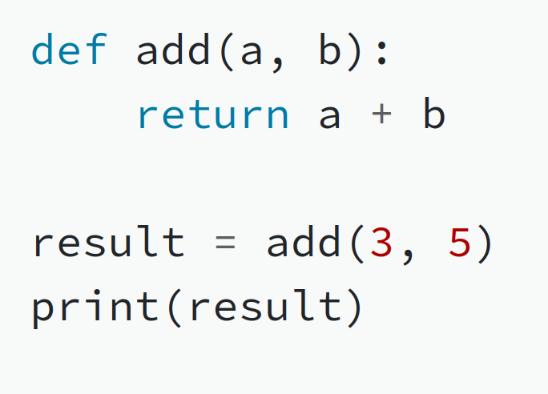
Objects and Functions
Python is an object-oriented programming language.
You should try to think about your code as being made up of objects (numbers, text, lists etc), and functions that act upon those objects (and usually return a new object as the output).
For example, we create a function called add(), which takes two numbers and returns the sum. We also use the built-in print() function to print the result.

Slide 27
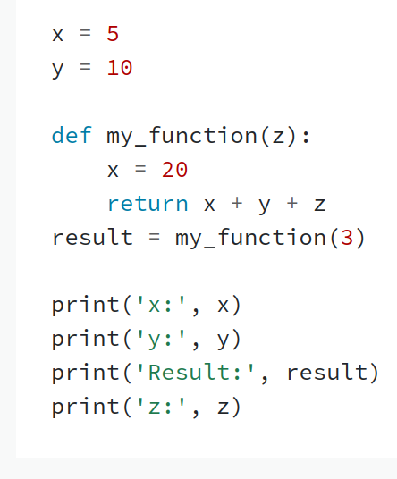
Scope
A variable defined within a function can only be accessed within that function. This is the scope of the variable.
Any variable outside of a function is in the global scope, and can be accessed from anywhere (including within functions).
Structure Challenge #1:
What will this code output?

Slide 28
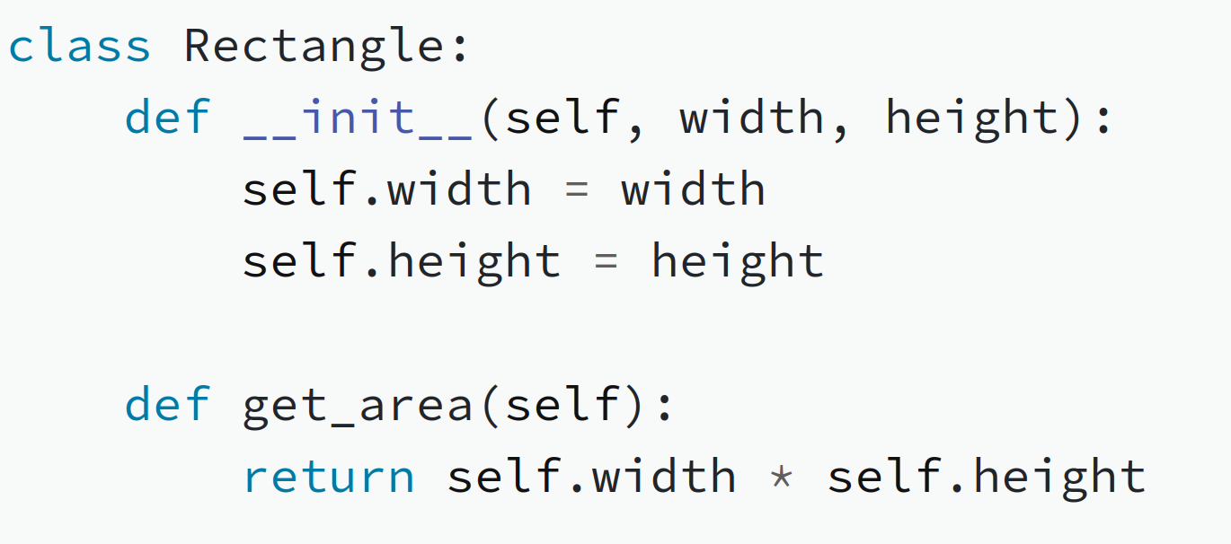
Classes
Every Python object has a class, like int for integers or str for text.
You can also create your own classes, which can have properties and methods.
Here we make a simple Rectangle class, which has properties for width and height and a method to find its area (note the use of the self keyword).

Slide 29
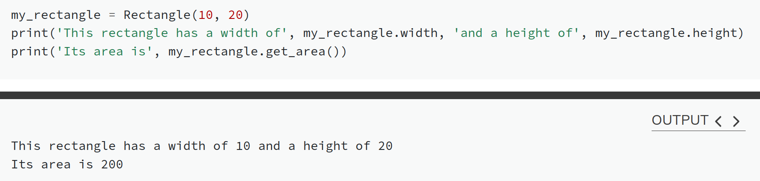
Classes
Each time you call a class you create a new instance, which can have different properties.
You can then access the properties and methods using the . operator:

Slide 30
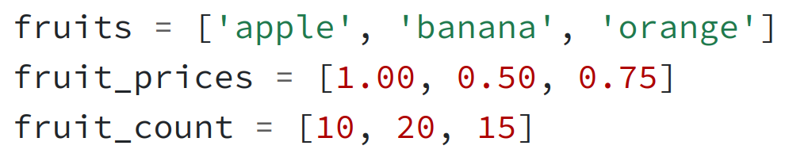
Classes
Structure Challenge #2
The code below defines various items in stock at a grocery store. Each item has a name, price, and the number in stock.
Create a Stock class with name, price and count properties, plus a method display() to print the name and price, and a method to get_total_value() which returns price times count.

Slide 31
Classes
Structure Challenge #3
Now create a Shop class, which takes as an input a list of Stock objects.
It should have two methods:
display_stock(), which calls the display() method on each item in the stock list
get_total_stock_value(), which returns the total value of all items in the stock list

Slide 32
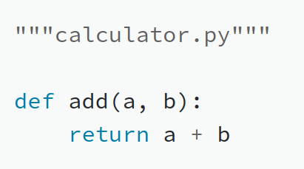
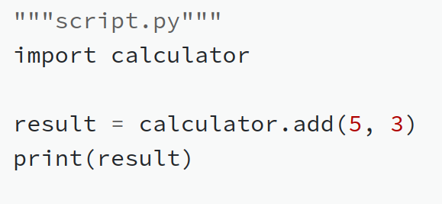
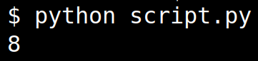
Scripts and Modules
Python scripts are files that are executed by the Python interpreter on the command line, e.g. $ python my_script.py.
Once your code is too large for a single script, you can put functions and classes in separate files (modules) and then import them into the script.
module:
script:
command line:

Slide 33
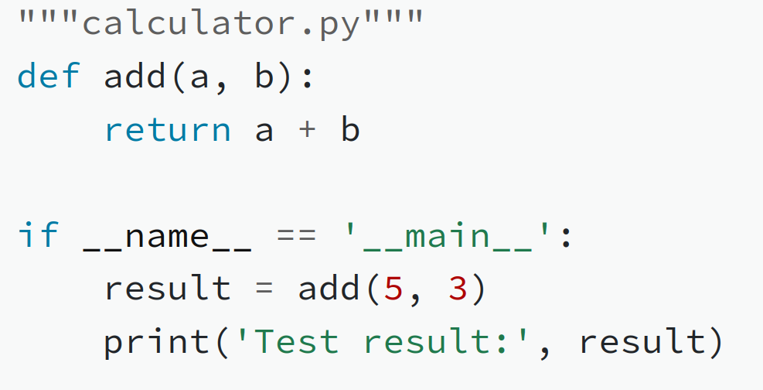
Executing code in modules
Any code in a module is executed when the module is imported.
If you still want some lines to be called when the file is run as a script, you can use the special check if __name__ == '__main__':

Slide 34
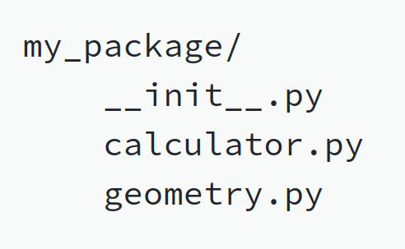
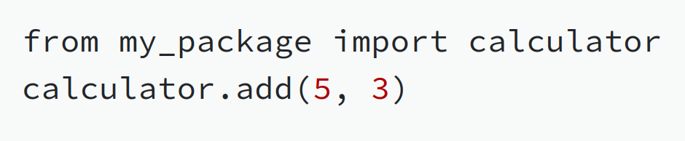
Packages
A collection of scripts and modules is called a package.
Packages are organised into directories which contain a file called __init__.py.
This file doesn’t have to contain anything, but it works to mark a directory as containing modules to import.

Slide 35
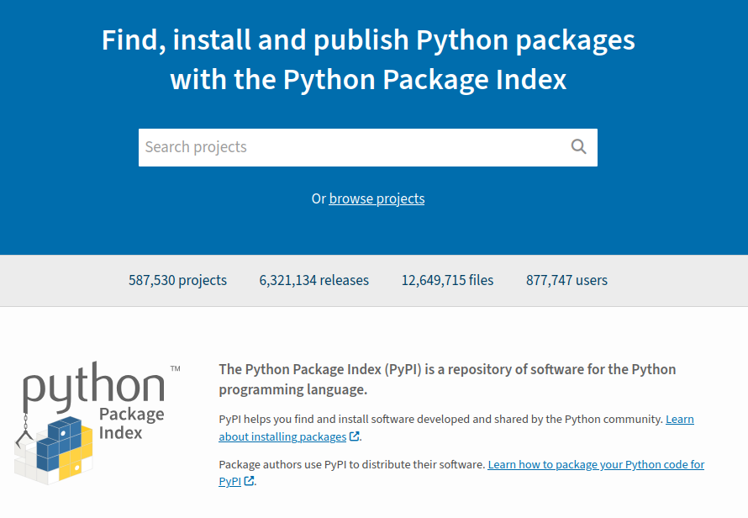
Packages
Python has a huge number of packages on the Python Package Index (https://pypi.org), which can be easily downloaded and installed using pip or conda.
We will cover how to create a formal Python package and share it with others in a future FAIR² session.

Slide 36
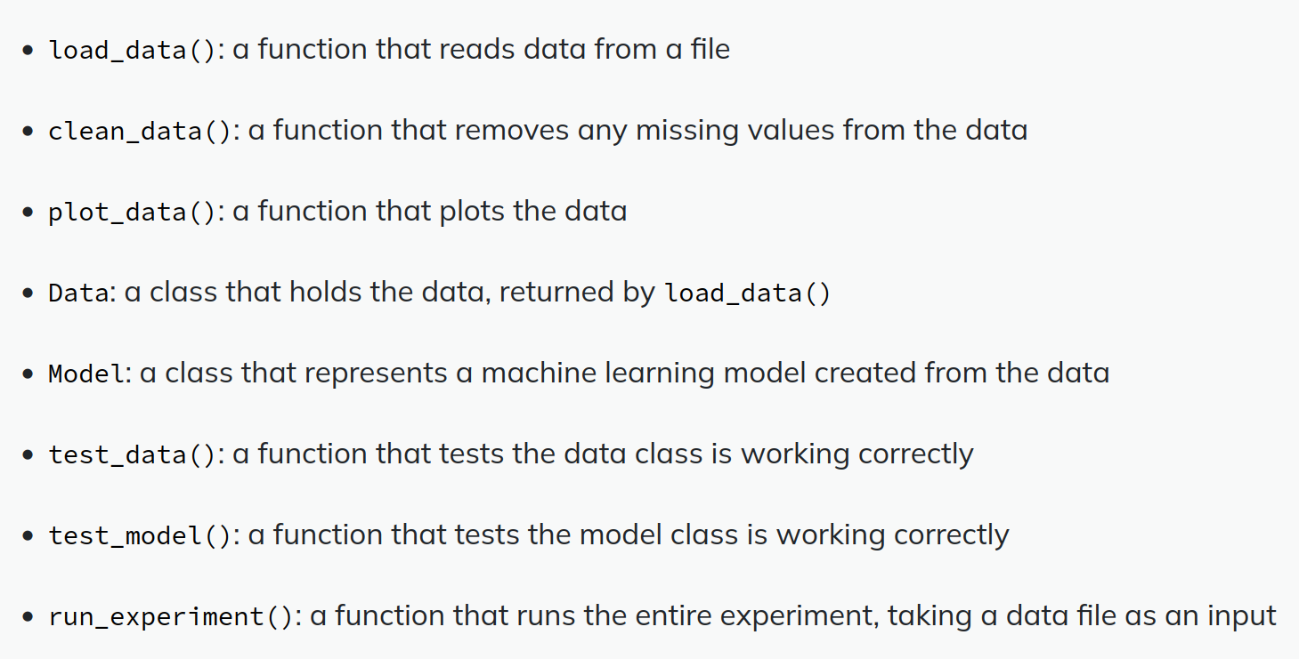
Packages
Structure Challenge #4
A single Python file contains the following functions and classes:
How would you organise this into a package with multiple modules?

Slide 37
Code structure final exercise
Download this Python script:
https://fair2-for-research-software.github.io/
FAIR_Code_design/files/student_scores.py
The script reads in data about a class of students, and prints out various results like their total scores, the average score per exercise and which student is leading the class.
Hopefully you should be able to see how to rewrite the code to use a data class and replace the repetitive code with common functions and methods.

Slide 38
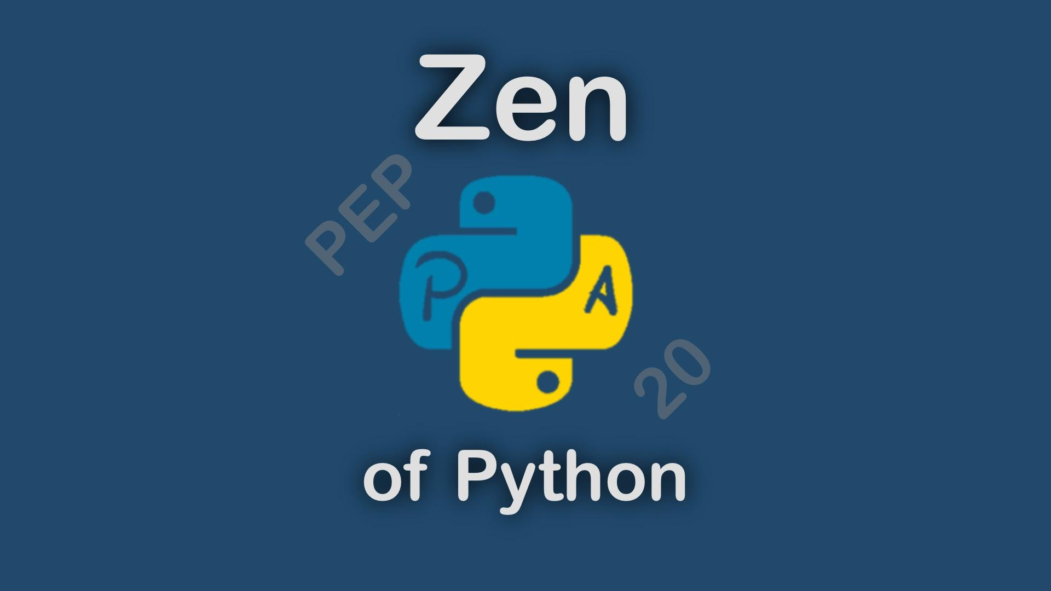
https://elpythonista.com/zen-of-python

Slide 39
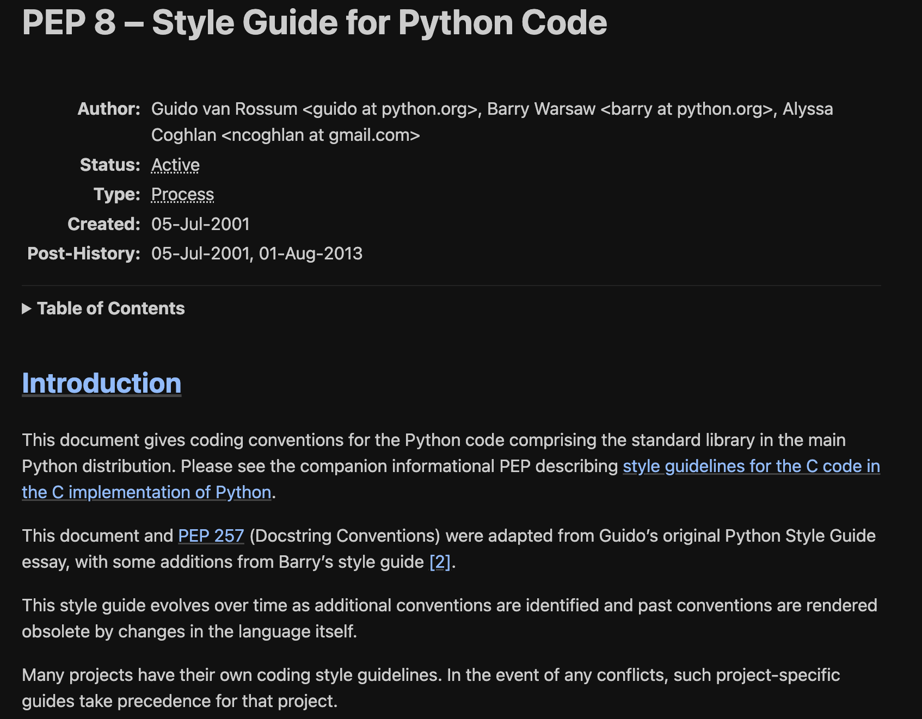
PEPs: Python Enhancement Proposals
→ Design documents that provide information to the Python community about new features, processes or environments.
Some of them are dedicated to design and style considerations:
PEP8 : Rules to write out Python code
PEP257: Convention to write docstrings

Slide 40
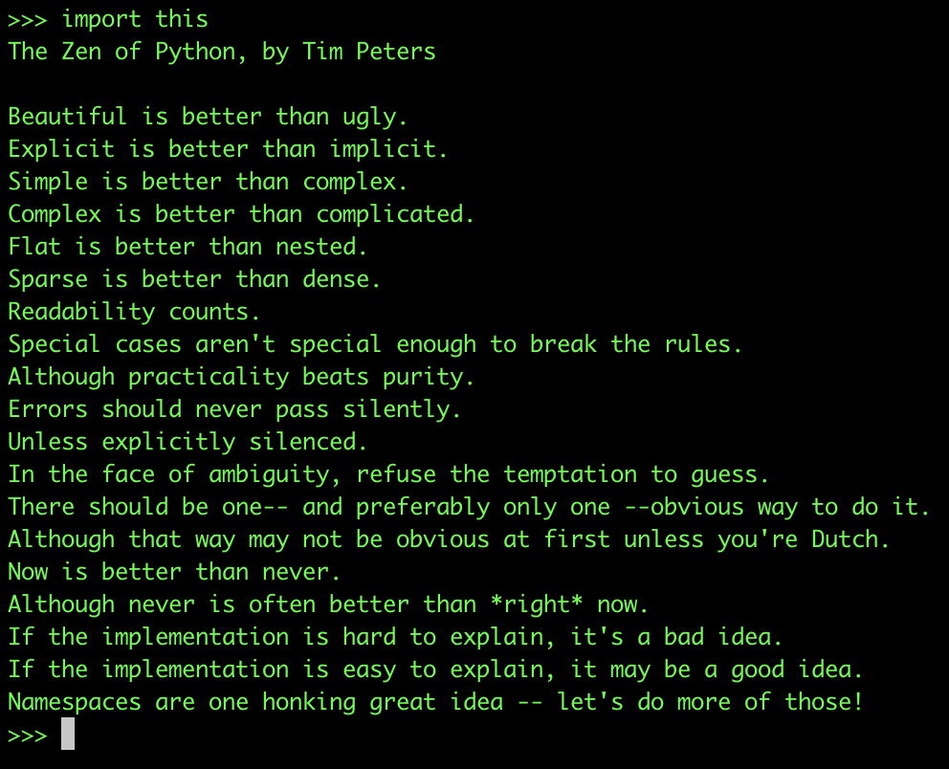
PEP20 : The Zen of Python
Python easter egg. It proposes 20 aphorisms that guide the development of Python software
Is is accessible from the python interpreter.

Slide 41
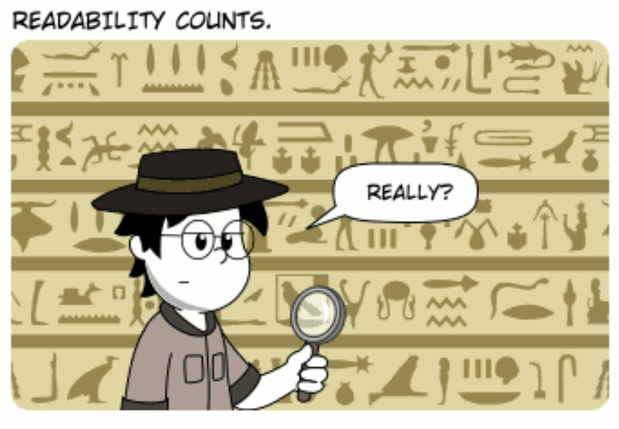
The Zen of Python: Readability count
A code is read much more often then it is written
Guido van Rossum, BDFL of Python
AUTHOR: Karlisson M. Bezerra, hacktoon.com
You might spend hours/days writing a piece of code. Then you will never write it again. But you might have to read it again and again and again. Understanding a code after a few weeks/months is not easy.
→ Following standard guidelines will greatly help you and save a lot of time!

Slide 42
The Zen of Python: Readability count
So how do we make a code more readable?

Slide 43
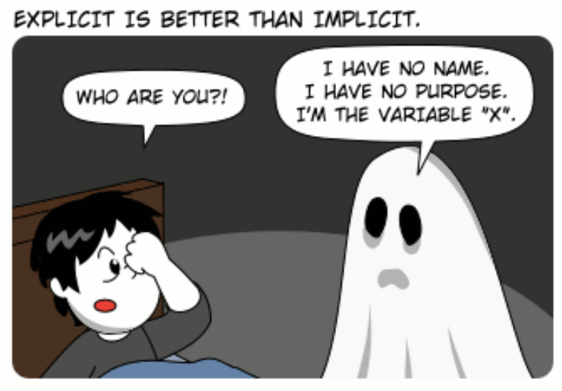
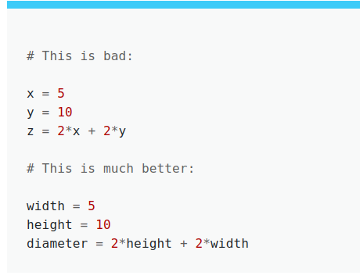
The Zen of Python: Explicit is better than implicit
AUTHOR: Karlisson M. Bezerra,
hacktoon.com
1st step:
Write code that is meaningful!
Give sense to all quantity that you write in your code

Slide 44
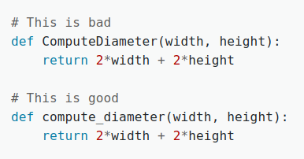
The Zen of Python: Explicit is better than implicit
2nd step:
Everything you write has a way to be written
Variable, function and methods use the snake_case convention
→ Lowercase, words separated by underscores.

Slide 45
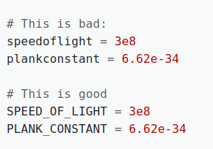
The Zen of Python: Explicit is better than implicit
2nd step:
Everything you write has a way to be written
Constant names follow the UPPER_SNAKE_CASE convention
→ Each word is written in capital letters, words are separated by underscores

Slide 46
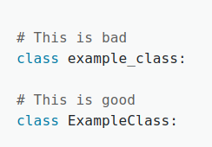
The Zen of Python: Explicit is better than implicit
2nd step:
Everything you write has a way to be written
Class names follow the PascalCase (or CamelCase) convention
→ Each words start with Capital, words are NOT separated by underscores.

Slide 47
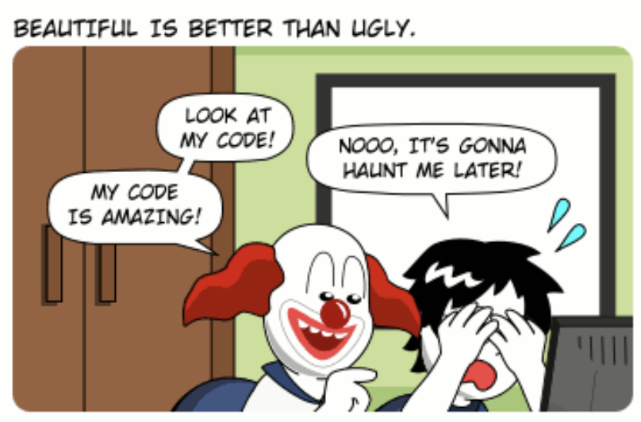
The Zen of Python: Beautiful is better than ugly
3rd step:
Always try to write code that is easy to understand (=Beautiful!)
You should go for simple solution. If you try to cram as much functionalities as possible in a single line it will takes ages to understand.. Break down the code in simple components.
AUTHOR: Karlisson M. Bezerra, hacktoon.com

Slide 48
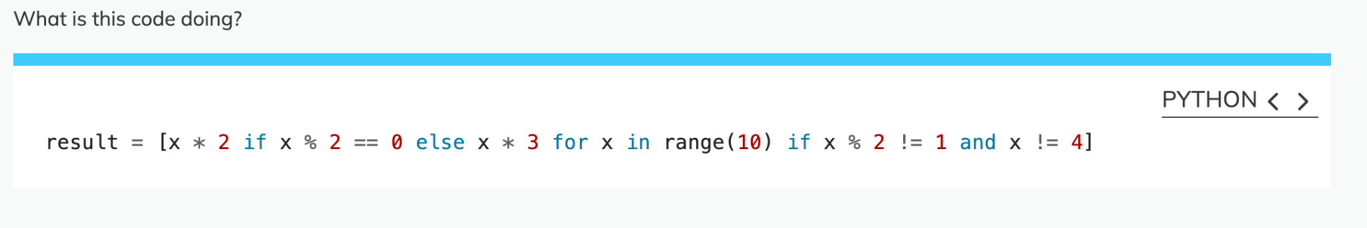
The Zen of Python: Beautiful is better than ugly
3rd step:
Always try to write code that is easy to understand (=Beautiful!)
You should go for simple solution. If you try to cram as much functionalities as possible in a single line it will takes ages to understand.. Break down the code in simple components.
Zen Challenge #1

Slide 49
The Zen of Python: Beautiful is better than ugly
3rd step:
Always try to write code that is easy to understand (=Beautiful!)
You should go for simple solution. If you try to cram as much functionalities as possible in a single line it will takes ages to understand.. Break down the code in simple components.
Zen Challenge #2: Rewrite it to make it more understandable

Slide 50
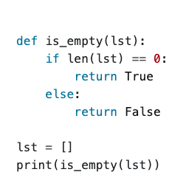
The Zen of Python: Beautiful is better than ugly
3rd step:
Always try to write code that is easy to understand (=Beautiful!)
Which does not mean you should over-complexify things…
Zen Challenge #3: Rewrite the following code in two lines

Slide 51
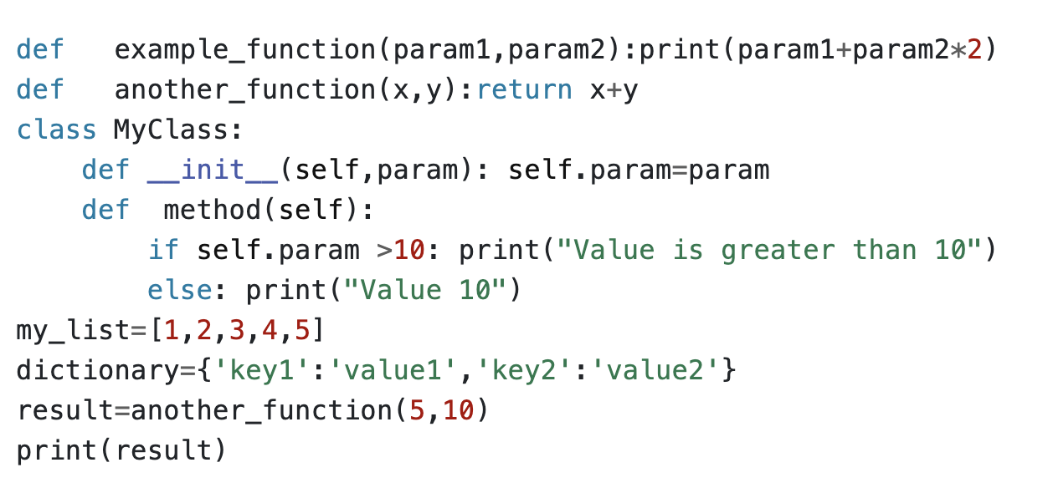
The Zen of Python: Sparse is better than dense
Zen Challenge #4:
Is it actually working?

Slide 52
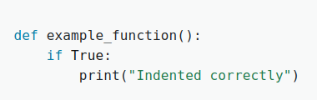
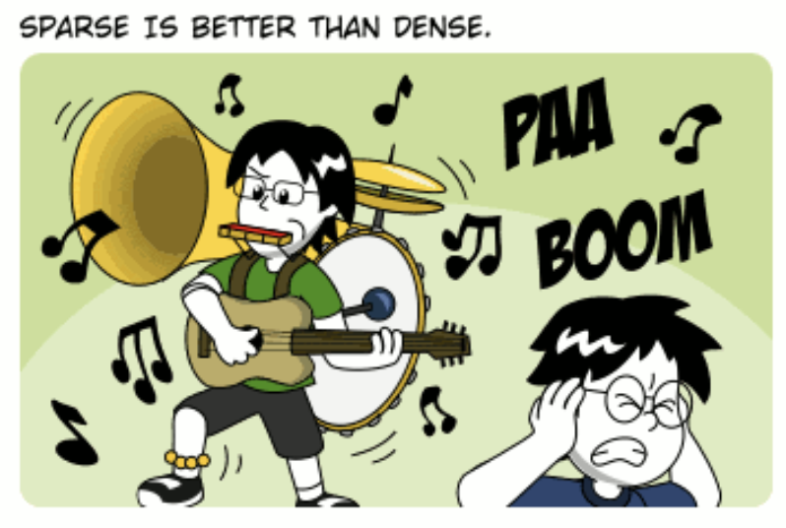
The Zen of Python: Sparse is better than dense
Fourth step:
Avoid cluttered code by making it sparse and spaced out.
Use whitepaces, correct indentations and separation
Rules:
Indentation: 4 spaces (don’t use tabs)
AUTHOR: Karlisson M. Bezerra, hacktoon.com

Slide 53
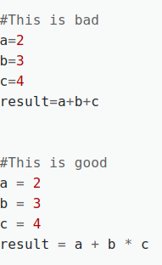
The Zen of Python: Sparse is better than dense
So what are the rules?
Rules:
Indentation: 4 spaces (don’t use tabs)
Whitespaces around operators
Fourth step:
Make your code easy to read, include spaces!!!
Avoid cluttered code by making it sparse and spaced out.
Use whitepaces, correct indentations and separation

Slide 54
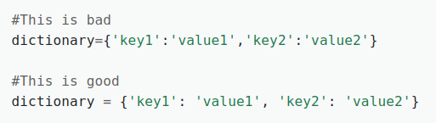
The Zen of Python: Sparse is better than dense
So what are the rules?
Rules:
Indentation: 4 spaces (don’t use tabs)
Whitespaces around operators
Comma and colon spacing: single space after common, space after the colon
Fourth step:
Make your code easy to read, include spaces!!!
Avoid cluttered code by making it sparse and spaced out.
Use whitepaces, correct indentations and separation

Slide 55
The Zen of Python: Sparse is better than dense
So what are the rules?
Rules:
Indentation: 4 spaces (don’t use tabs)
Whitespaces around operators
Comma and colon spacing: single space after common, space after the colon
Blank lines: 2 blank lines before a top level function or class definition, single blank line between method definitions
Fourth step:
Make your code easy to read, include spaces!!!
Avoid cluttered code by making it sparse and spaced out.
Use whitepaces, correct indentations and separation

Slide 56
The Zen of Python: Sparse is better than dense
Zen Challenge #5: Create a new python file and correct the syntax based on the previous rules

Slide 57
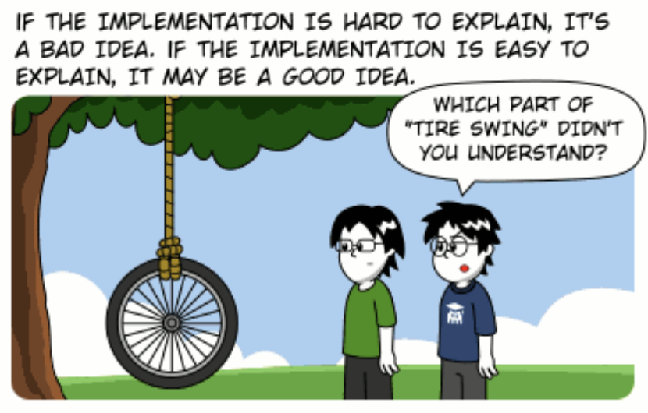
The Zen of Python: If the implementation is hard to explain it is bad
Fifth step:
Writing simpler and more logical code is a good starting point. But adding comments is very important! Few rules apply:
Comments should be (real) sentences
Block comments apply to the piece of coming after them
Comments should not state the obvious (don’t make distraction)
Keep your comments up to date!
→ ‘Comments contradicting the code are worse than no comments’
AUTHOR: Karlisson M. Bezerra, hacktoon.com

Slide 58
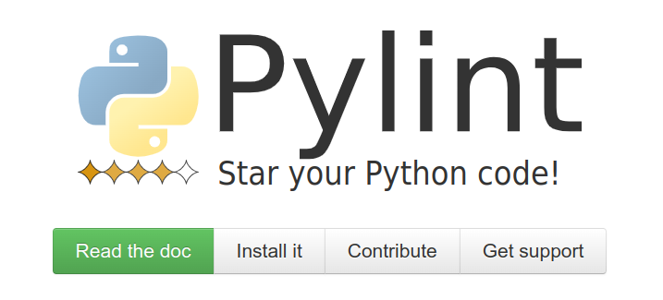
The Zen of Python: Don’t want to remember all this?
Pylint is a tool that analyzes Python code to find programming errors, enforce a coding standard, and look for improvements. It provides a score based on the number of issues detected, helping you writing clean and readable code.

Slide 59
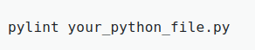
The Zen of Python: Don’t want to remember all this?
It will identify Errors in Syntax, undefined variables, useless imports, highligh duplicated code, etc… It will check the code against PEP8 and verify all the coding standards that we just discussed.
To run Pylint on your code it is as simple as

Slide 60
The Zen of Python: Don’t want to remember all this?
It will identify Errors in Syntax, undefined variables, useless imports, highligh duplicated code, etc… It will check the code against PEP8 and verify all the coding standards that we just discussed.
To run Pylint on your code it is as simple as
Zen Challenge #6: Take the last code, apply pylint and clean it up!

Slide 61
The Zen of Python: Don’t want to remember all this?
To finish:
It is possible to tune Pylint with a configuration file
Many Integrated Development Environment support Pylint integration.→ You can see linting results directly as you write the code.
Github actions can be used to check the code automatically.

Slide 62
Coding Principles

Slide 63
What are coding principles?
Coding principles are guidelines and best practices that anybody writing code should follow to write clean, maintainable, and efficient code.
These principles enhance the quality of code and ensure it is readable, reusable, and less prone to errors.

Slide 64
What are coding principles?
Coding principles are guidelines and best practices that anybody writing code should follow to write clean, maintainable, and efficient code.
These principles enhance the quality of code and ensure it is readable, reusable, and less prone to errors.
They are all easy to understand and to remember. And they are quite obvious!
Today we will have a look at a few of them:
YAGNI
KISS and Curly’s Law
DRY and the rule of three
POLA

Slide 65
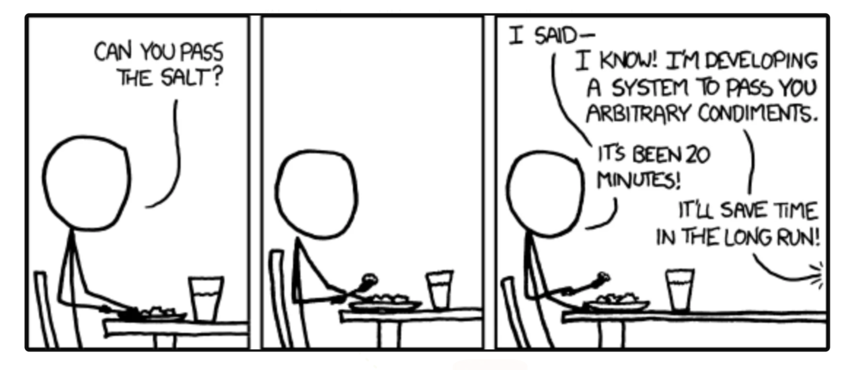
YAGNI: You aren’t gonna need it
YAGNI encourages you to build ONLY what you need RIGHT NOW.
→ Do not add features for hypothetical future needs.
→ Coming from Agile programming, it aims to reduce wasting time and resources on unnecessary code.

Slide 66
YAGNI: You aren’t gonna need it
Why?
Simplicity: Unnecessary code introduce complexity and is harder to read (Why is this implemented???)
Saving time: Unnecessary code takes time to write!
Flexibility: If you write JUST what is needed it is easier to implement changes

Slide 67
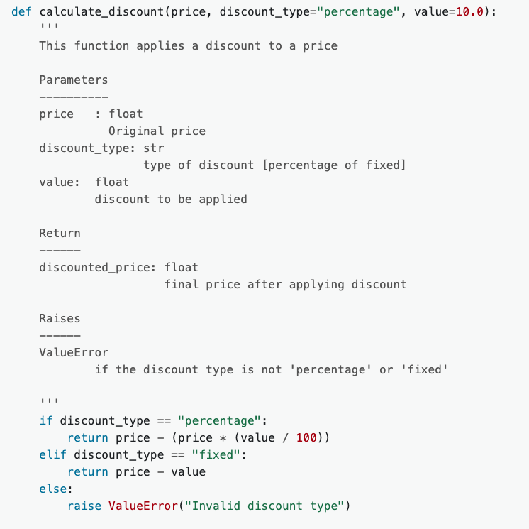
YAGNI: You aren’t gonna need it
An example:
The instruction here are to create a simple function that implements a percentage discount price.
→ Look at the implementation →
What can you say about it with respect to the YAGNI principle?

Slide 68
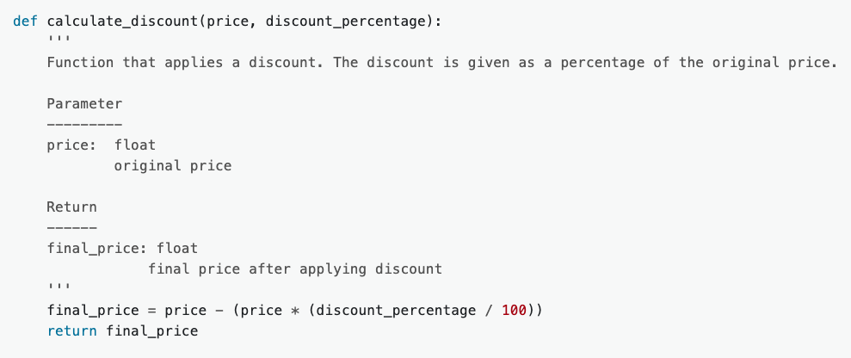
YAGNI: You aren’t gonna need it
An example:
The instructions here are to create a simple function that implements a percentage discount price.
Here is a better version following the YAGNI principle:

Slide 69
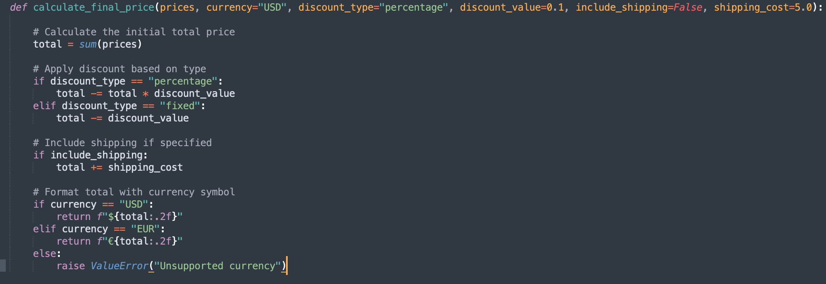
YAGNI: You aren’t gonna need it
Principle challenge #1
Context:
You’re working on a feature to calculate the final price of items in a shopping cart. Right now, the only two requirements are
(1) to apply a fixed 10% discount to the total cart price
(2) return the final price with a $ sign in front of the total price (e.g. $42.2).

Slide 70
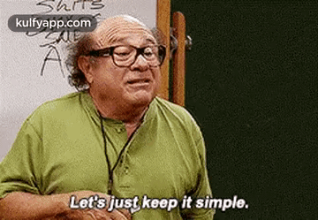
KISS and Curly’s law
KISS stands for ‘Keep it simple, stupid’. It exists to remind you that writing simple code should be a primary goal in design.

Slide 71
KISS and Curly’s law
Why?
Reusability: Simple single-task function are easier to reuse.
Bug fix: When you code is composed of simple function, potential issues are easier to localise.
Testing: Simple single-task function are easier to test.
Modularity: Code becomes more modular and organized.

Slide 72
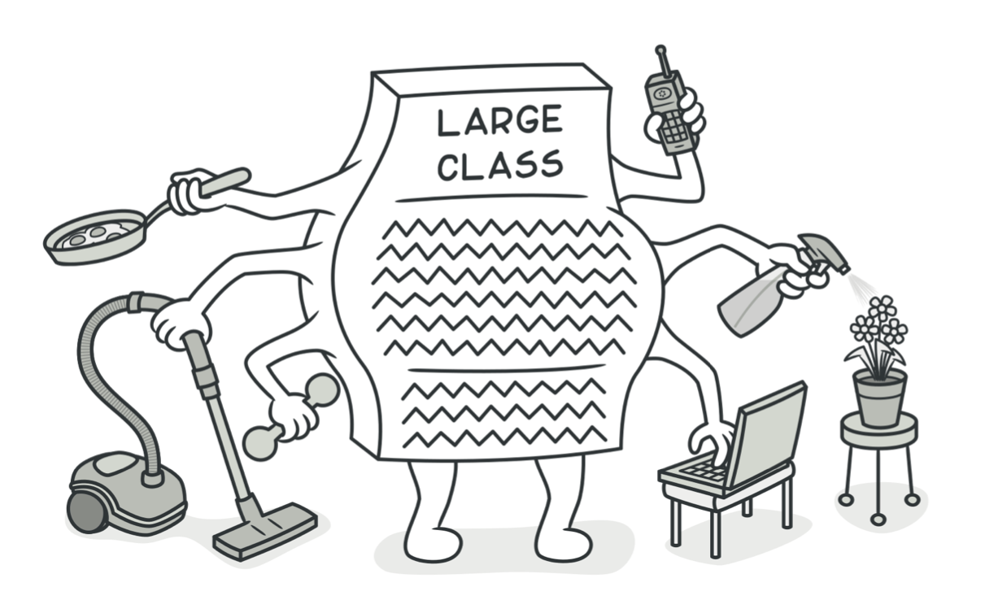
KISS and Curly’s law
Curly’s law
This ‘law’ says that each function should ‘do one thing’ and ‘do it well’
→ If a function has multiple tasks, consider breaking it down

Slide 73
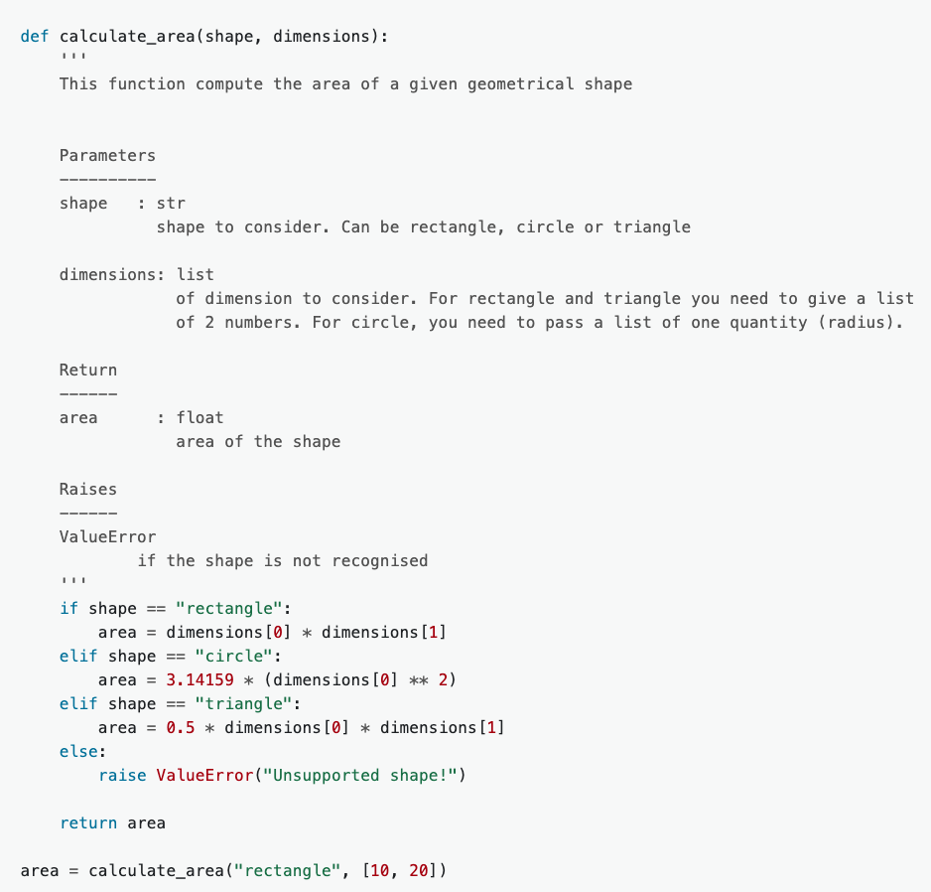
KISS and Curly’s law
An example:
Let’s consider a function that compute the area of circles, rectangles and triangles →
What would you do to make this code more easy?

Slide 74
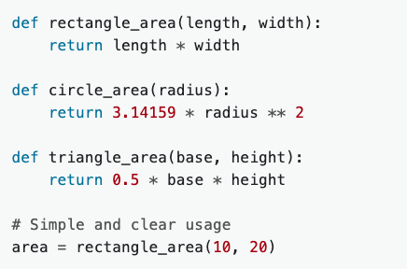
KISS and Curly’s law
An example:
In that version, functions are specific and easy to understand and there is no unnecessary complexity in shape management. It is easier to maintain and extend.

Slide 75
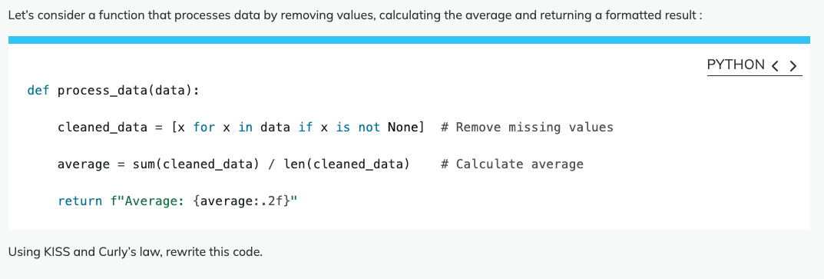
KISS and Curly’s law
Principle challenge #2

Slide 76
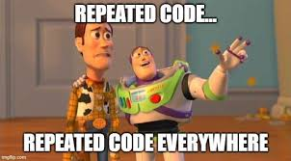
DRY and Rule of Three
DRY stands for ‘Don’t repeat yourself’. It encourages you to minimize duplication by refactoring similar code patterns.

Slide 77
DRY and Rule of Three
Why?
Improves Readability: Code is clearer when it's not cluttered with repeated part.
Reduces Bugs: If you need to make changes, you only do it in one place, reducing the chance of errors.
Saves Time: Updating and testing code is faster when code is organized with minimal duplication.

Slide 78
DRY and Rule of Three
BUT don’t go too fast!!
Prematurely refactoring a code might lead to unnecessary complexity.
→ Dry is associated with the Rule of Three.
→ You should wait until a piece of code is repeated three times before refactoring it. It ensures that you only refactor when a pattern is stable and repeated enough time

Slide 79
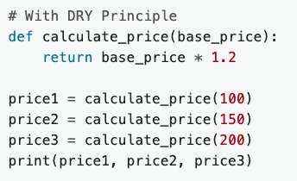
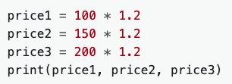
DRY and Rule of Three
In practice:
Using function to refactor code that is the same in multiple places

Slide 80
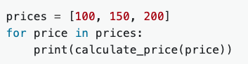
DRY and Rule of Three
In practice:
Using loops instead of manual repetition:

Slide 81

DRY and Rule of Three
In practice:
Using constant for common values:

Slide 82

DRY and Rule of Three
Principle challenge #3

Slide 83

POLA: Principle of least astonishment
POLA states that the code you are writing should work in a way that does not surprise the users and maintainers.
→ It should align with common expectations.
https://medium.com/@mesw1/the-principle-of-least-astonishment-making-intuitive-software-46d9ae1b8abe

Slide 84
POLA: Principle of least astonishment
Why?
Usability: When code works as expected, users and maintainers are less likely to misuse or misunderstand it.
Maintainability: Familiar and predictable patterns make the code easier to maintain and upgrade.
Collaboration: Using consistent and intuitive code make it easier for multiple people to work with and develop.
https://medium.com/@mesw1/the-principle-of-least-astonishment-making-intuitive-software-46d9ae1b8abe

Slide 85

POLA: Principle of least astonishment
Common violations:
- Unexpected Return Types: Functions that return types users wouldn’t expect, such as a function sometimes returning an integer and other times returning None.

Slide 86

POLA: Principle of least astonishment
Common violations:
- Multiple Functionalities: Using functions for multiple unrelated tasks often leads to unexpected behaviors.

Slide 87

POLA: Principle of least astonishment
Principle challenge #4

Slide 88

Don’t touch your code anymore!

Slide 89
Don’t touch your code anymore!
Two solutions:
Change these parameters in the code itself.
Get the setting of these parameters out of the code.
When coding for a research project you might find yourself trying to rerun your code with different settings.

Slide 90
Don’t touch your code anymore!
Two solutions:
Change these parameters in the code itself.
Get the setting of these parameters out of the code.
Configuration files
Command line interfaces [CLI]

Slide 91

Don’t touch your code anymore!
Configuration file [CF] is a generally a text file with a particular structure that allows you to set up the initial configuration of your software.

Slide 92
Don’t touch your code anymore!
Easier reproducibility: saving the CF you can reproduce previous results later.
Minimize code modification: Parameters are externalised, code is cleaner and more maintainable.
Collaboration: it is easy to share, and people can adjust the use of your code for their own need
Documentation: It serves as documentation for your run
Git: you can version your CF along your code.

Slide 93

Don’t touch your code anymore!
Multiple types of configuration files exists in Python:
INI file: Easy to read and parse. Can be done without extra library installation. Everything is a string.
TOML file:
JSON file:
YAML file

Slide 94

Don’t touch your code anymore!
Multiple types of configuration files exists in Python:
INI file: Easy to read and parse. Can be done without extra library installation. Everything is a string.
TOML file: A bit more recent, they allow structure and understand data format. Available from Python 3.11.
JSON file:
YAML file

Slide 95

Don’t touch your code anymore!
Multiple types of configuration files exists in Python:
INI file: Easy to read and parse. Can be done without extra library installation. Everything is a string.
TOML file: A bit more recent, they allow structure and understand data format. Available from Python 3.11.
JSON file: Popular in Web apps, they are [a little] more complex to write. Do not allow comments.
YAML file

Slide 96

Don’t touch your code anymore!
Multiple types of configuration files exists in Python:
INI file: Easy to read and parse. Can be done without extra library installation. Everything is a string.
TOML file: A bit more recent, they allow structure and understand data format. Available from Python 3.11.
JSON file: Popular in Web apps, they are [a little] more complex to write. Do not allow comments.
YAML file: Easy to write, allow structure and very popular (Github actions use them). Not available in the
Standard library

Slide 97

Don’t touch your code anymore!
Conf and CLI challenge #1

Slide 98

Don’t touch your code anymore!
Using INI configuration files in Python
Python gives you the configparser library. Allows you to read and write configuration file in a very easy way
→ Part of the standard library.

Slide 99

Don’t touch your code anymore!
Reading an INI configuration file is very easy and can be done in three lines:

Slide 100



Don’t touch your code anymore!
From here you can access all the data inside the file:
Get all the sections
Get all keyword names in a section
Get all pairs in a section

Slide 101



Don’t touch your code anymore!
From here you can access all the data inside the file:
Turn a section into a dictionary
Access a value of a keyword in a section
By default everything is a str but You can use getint(), getfloat() or getboolean()

Slide 102

Don’t touch your code anymore!
In some occasion, you might want to write configuration files as well!
It starts like before:

Slide 103

Don’t touch your code anymore!
Creating a configuration is equivalent to create dictionaries:
Section
Content of section

Slide 104


Don’t touch your code anymore!
That’s what you get:
And then you save it into a file:
Open in ‘write’ mode
Name of the final file

Slide 105

Don’t touch your code anymore!
Conf and CLI challenge #2
-Read it using the configparser library
-change the number of beetroots to 2 and the number of oranges to 5.
-Add a section ‘pastries’ with 5 croissants.
-Then save it back on disk in a different file.

Slide 106

Don’t touch your code anymore!
Command line interfaces [CLI] is a text based interface used to interact with software and operating systems.

Slide 107
Don’t touch your code anymore!
Configuration: CLI allows you to modify the configuration without touching the code.
Quick execution: It is often faster to use a CLI then using a GUI
Documentation: CLI helps document the use of your code (--help command)
Adding new feature: Adding arguments is very easy
HPC and batch processing: HPC are often giving you a terminal. Using CLI makes the use of your code easy. CLI commands can be easily scripted to automate tasks.

Slide 108

Don’t touch your code anymore!
Creating a command line interface in Python
Python gives you the argparse library. Allows you to create user friendly command line interfaces with a very limited amount of line.
→ Part of the standard library.

Slide 109


Don’t touch your code anymore!
Let’s create one!
No need to install it!
This is seen by the user when asking for the help
Then you need to tell your code to analyse (parse) the arguments passed by the user:

Slide 110

Don’t touch your code anymore!
You just created your first CLI!
Description of the program
Tells the user how to run it
Save the previous lines in a file called ‘cli_course.py’ and run:
python3 cli_course.py --help
Help argument is coming by default
Epilog

Slide 111
Don’t touch your code anymore!
You just created your first CLI! But it is not very useful for the moment.
Let’s add arguments!
Two types exist:
- Optional arguments: start by `-` or `--` and are called in the terminal by their name. They can be ignored by the user.
- Positional arguments: Their name DO NOT start by `-` or `--`, the user cannot ignore them and they are not to be called by their name (just the value needs to be passed).

Slide 112

Don’t touch your code anymore!
You just created your first CLI! But it is not very useful for the moment.
Let’s add arguments!
In practice ( before the line args = parser.parse_args() ):

Slide 113

Don’t touch your code anymore!
You just created your first CLI! But it is not very useful for the moment.
Let’s add arguments!
Mandatory arguments
Non-Mandatory arguments

Slide 114

Don’t touch your code anymore!
You just created your first CLI! But it is not very useful for the moment.
Let’s add arguments!
Like this, the help is not very helpful. We don’t know what the argument are there for. → Help the user!
Description for each argument

Slide 115
Don’t touch your code anymore!
You just created your first CLI! But it is not very useful for the moment.
Let’s add arguments!
For the moment, the user can pass whatever values and they would be accepted. It is possible to tune the argument a little bit more:
‘actions’: allows you to store boolean values
→ ex: parser.add_argument(‘-x’, action=’store_true’)
‘default’: allows you to add a default value to the argument in case the user does not use it.
→ ex: parser.add_argument(‘-x’, default=5)

Slide 116
Don’t touch your code anymore!
You just created your first CLI! But it is not very useful for the moment.
Let’s add arguments!
For the moment, the user can pass whatever values and they would be accepted. It is possible to tune the argument a little bit more:
‘type’: enforce the type of value that the user must give
→ ex: parser.add_argument(‘-x’, type=int)
‘choices’: Enforce the value to be passed to be amongst a list of allowed values
→ ex: parser.add_argument(‘-x’, choices=[‘blue’, ‘red’, ‘green’])

Slide 117

Don’t touch your code anymore!
You just created your first CLI! But it is not very useful for the moment.
Now we must get the values from the CLI!
We already know that line:
Everything is in ‘args’:

Slide 118

Don’t touch your code anymore!
You just created your first CLI! But it is not very useful for the moment.
Error!!!!
1st positional arguments
All of them!
‘max’

Slide 119

Don’t touch your code anymore!
Conf and CLI challenge #3

Slide 120

Don’t touch your code anymore!
Final challenge!
Check your mails!

Slide 121

Help us improve!
Scan to give us feedback!

